Slide 1

Predicting Ticket Price for Big Mountain Resort
Capstone Project

Slide 2
Problem Identification
Big Mountain Resort would like to identify the dollar impact of controllable factors on ticket price Goal:
Understand how to set price tickets by
Maximize return on business investments
Reduce costs while minimizing revenue loss

Slide 3
Potential Limitation
The analysis modeling was based on 27 features from 330 resorts. Ticket value may best be predicted by variables outside of this dataset.
Only revenues are considered – Big Mountain resort management will have to consider expenses/operation costs to determine if modeled scenarios will be profitable.

Slide 4
Recommendations & Key Findings
Recommendations:
Raise ticket prices to $83.83
Close a single run to cut costs
Raise prices to $94.22 gradually
Potentially gain revenue by increasing vertical drop by 150ft with the addition of a chair lift and 2 acres of snowmaking
Key Findings:
Closing multiple runs is potentially profitable
Increasing vertical drop by 150 feet is potentially profitable
ticket price increase of $10.59 and will generate additional revenue of $18.5 million/year

Slide 5
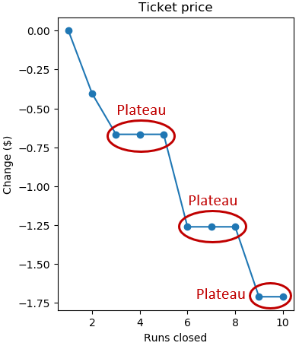
Summary of Analysis for Business Scenarios (1)
Run Closures (Max. 10 runs)
Closing 1 single run has no impact on ticket price
Closing 3,4,5 runs has an identical impact on the ticket price
Closing up to 5 runs results in drop in ticket prices and revenue
Cost/Benefit analysis is needed for decision making

Slide 6
Summary of Analysis for Business Scenarios (2)
Increase vertical drop by 150ft and addition of a chair lift
ticket price increase of $8.67 and additional revenue of $15 million
It requires to take account for cost of building and operating a new char lift
Number 2 plus the addition of 2 acres of snow making
ticket price increase of $10.59 and additional revenue for a total of $18.5 million
Increase the longest run by 0.2 miles (boasting the longest run) and additional snow making of 4 acres
Results in no change in ticket price

Slide 7
Next Steps
Setting $83.83 per ticket and closing one run to reduce cost
Exploring further ticket price increases
Investigating multiple run closures and vertical drop increase
Potential for future modeling:
additional data variables such as expenses/costs & visitors
Customers’ feedback (surveys/review)

